Slide 1
RL-Trade
An Experiment on Apply Deep Reinforcement Learning to train Equity Trading Agent
By Zhongheng Li
For CSCI E-89 Section 2 (25792) – Deep Learning

Slide 2
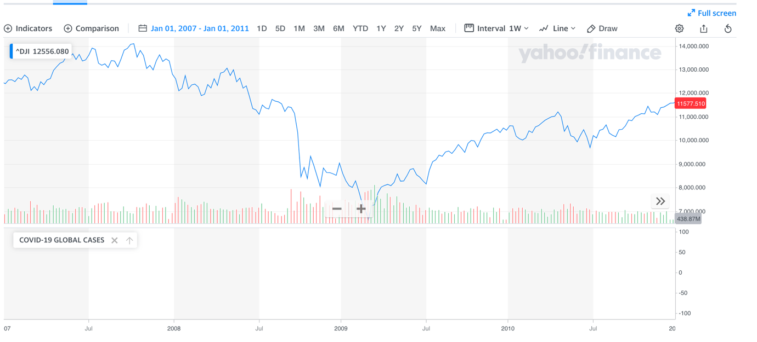
Problem Statement
In late 2008 the stock market crashed due to the Subprime Mortgage Crisis
The machine learning technologies back then were not as advanced and not as accessible as of now in 2020
Dow Jones Industrial Average from Jan 2007 – Jan 2011

Slide 3
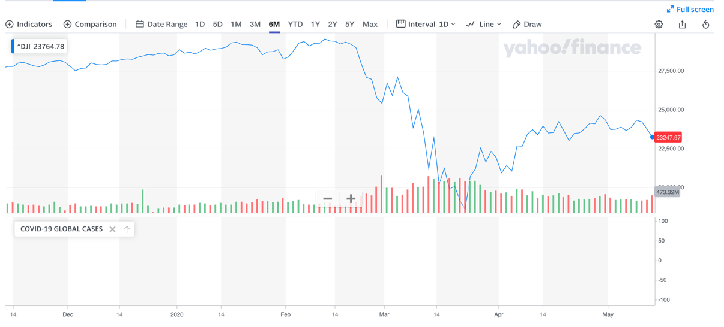
Problem Statement
As in 2020 humanity is facing an unprecedented crisis that due to the COVID-19
For economy alone, we are facing a much more serious financial crisis at global scale
Dow Jones Industrial Average from Dec 2019 – May 2020

Slide 4
Problem Statement
As in 2020, more than a decade after the last financial crisis, with many AI breakthroughs in recent years, can we leverage machine learning to assist us to get over the on going financial gap?
Can we leverage AI agent as an assistant to help us to hop over the financial gap year(s)?
Disclaimer – this project is simply an experiment to explore the feasibilities for apply machine learning in finance. There are many fin-techs and big financial companies are already doing this sim2real approach
For example JP Morgan’s ML trading on Foreign Exchange

Slide 5
Why Reinforcement Learning?
Traditional backtesting timeseries predictive approaches are deterministic and bounded by historical data
Basically turned the problem into a supervised learning problem
However, in the real world scenario the future is uncertain. Market volatility is full of unpredictable factors that we may not have the historical data to learn the movements of the stock price. For example, COVID-19 was not deterministic.
Instead of learn from the derivative from the passed stock movements, take the reinforcement approach to train an agent to obtain the capability to navigate the future scenarios.

Slide 6
Why Reinforcement Learning?
We are using RL, to train the agent to observe and react to different market environment by iterate through different different market data in different period of time
An agent will be given the state of the series of market data: 40 days of daily Open, High, Low, Close and Volume data
Based on the given state, the agent will predict the next best action to take to step forward to the next state
In our RL-Trade environment the agent can take the action of: But, Sell or Hold (Do nothing)
Based on the action, the environment will step into the next state and inform the agent the rewards / penalty for the move
The reward will be the updated net worth, profits and additional inflation penalties

Slide 7
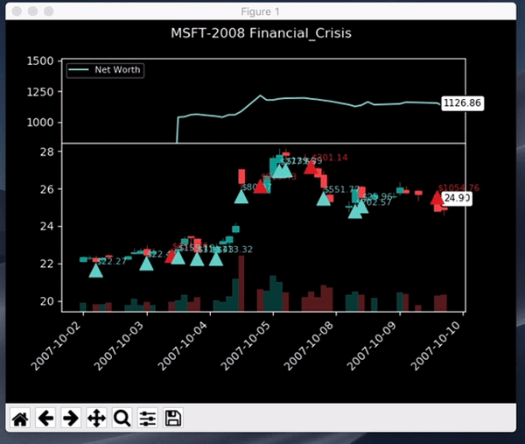
The Agent Training Environment – The Gym
Utilizing a very simple Stock Market OpenAI Gym based environment (GitHub repo) that create by Adam King.
Adam is one of the key contributor of the large scale RL trading framework Tensortrade
This is GIF to visualize how my initial trained agent is navigating the 08 Financial Crisis in the MSFT stock space

Slide 8
The Agent Training Environment – The Gym
The updates and enhancements I made to Adam’s OpenAI gym environment
Updated the reset function to take in the option to perform Uniform Domain Randomization(UDR)
Updated the render function to export training data for visualizing the movements and decisions from the agent overtime
Also added the option to render in memory for faster performance and real time output in terminal
Updated the reward function to take consideration of inflation
Updated the observation space to increase the weights for the agent’s current state (balance, profits, share held, etc)
Updated the variables for the gym environment to be configurable

Slide 9
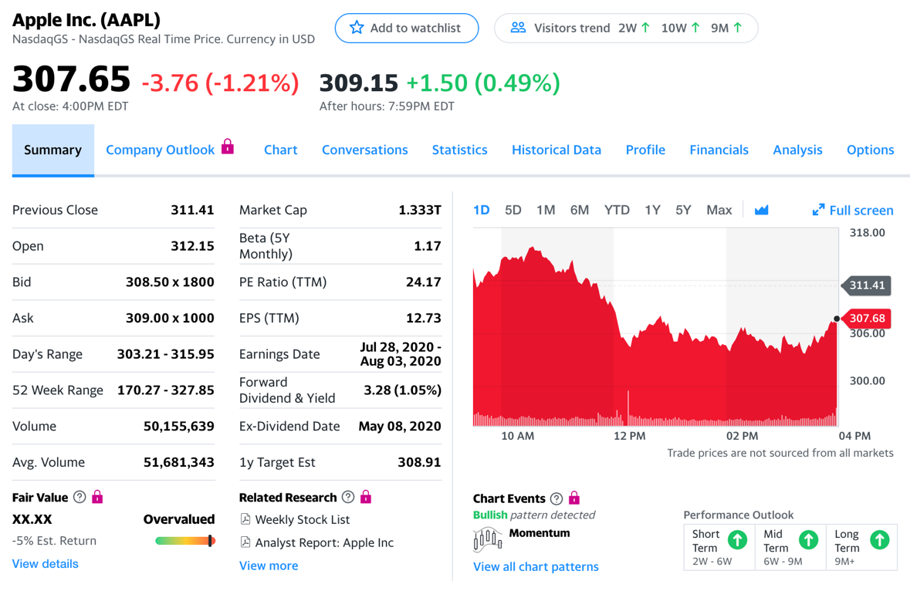
Data Source
Data from Yahoo Finance. Daily stock Open, High, Low, Close, Volume (OHLCV) data from May 1998 to May 2020 for the following 2 stocks:
Apple
Microsoft

Slide 10
Exploratory Data Analysis – Training Data
The overall close price trajectory of MSFT (1998 -2020)
The overall close price trajectory of AAPL (1998 -2020)

Slide 11
Exploratory Data Analysis – Testing Data to be held out
The overall close price trajectory of MSFT (Sep 07 – Sep 09)
The overall close price trajectory of AAPL (Sep 07 – Sep 09)

Slide 12
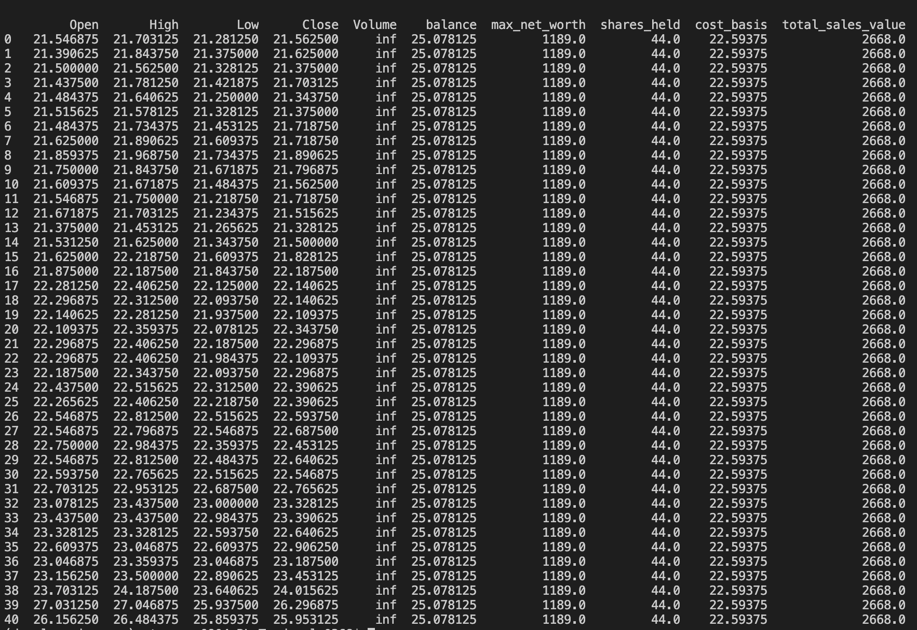
Data as Observation Apace
In each time step per day, the environment will provide the following data as the observation space for the agent to determine the optimal action to be taken for the next time step:
Currently, each observation space provided 40 days of historical market data + the current state of agent after the last 40 days

Slide 13
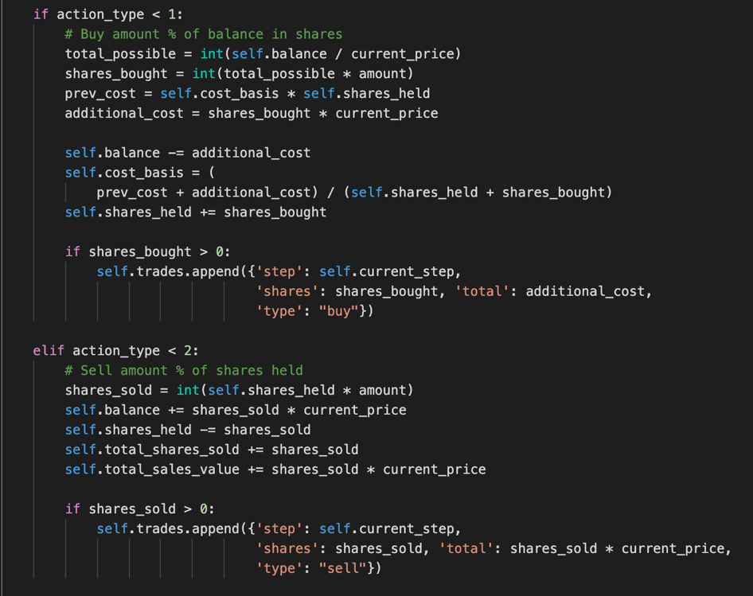

Data as Action Apace
The action space is included in the environment, it is designed based on a ReLu function.
There 3 actions to take: Buy, Sell and Hold (Do nothing)
The choices are discrete, but the output does provide continuous factor which make this problem a semi-continuous problem.
Sample action: [[1.245 0.07687 ]]
Blue is the action type value
Green is the number of shares based on the
percentage of current account balance to buy or sell
Rectified Linear Units (ReLU)

Slide 14
Data as Action Apace - Example
With this predicted action, the agent took the buy action and brought possible shares with 99% of it’s balance
action: [[0.05176, 0.991]]
Step: 45
Trading Date: 2007-10-22
Balance: 479.8368544771603
Shares held: 24 (Total sold: 124)
Avg cost for held shares: 22.478971695626672 (Total sales value: 2667.998947759153)
Net worth: 1024.7359215170877 (Max net worth: 1042.0290971997606)
Action: [0, 0]
Reward: 24.91586033751665
Profit: 24.735921517087718
Step: 46
Trading Date: 2007-10-23
Balance: 25.081674733842306
Shares held: 44 (Total sold: 124)
Avg cost for held shares: 22.596602282689958 (Total sales value: 2667.998947759153)
Net worth: 1025.5430701691416 (Max net worth: 1042.0290971997606)
Action: [0.05176 0.991 ]
Reward: 25.552684811122937
Profit: 25.54307016914163

Slide 15
Data as Rewards
I redesign the reward to be slightly more realistic by adding the inflation factor over time to encourage the agent to take buy or sell action instead of being satisfy with the current reward and hold the shares for long period of time
reward = balance * delay_modifier + profit - (cur_trial_step * (balance * INFLATION_RATE))
delay_modifier = current timestep / total timesteps
INFLATION_RATE = (0.015 / 360)

Slide 16
Approach 1 – Semi Continuous Deep Q-Network (DQN)
Our problem is a semi-continuous problem. We do have discrete actions, Buy. Sell and Hold, but we also have continuous number of shares we need to predict can buy/sell
DQN is not suitable for continuous problems. But as for our semi continuous problem we started with DQN
My SC-DQN implementation is built on top of this open source reference by Yash Patel

Slide 17
Approach 1 – Semi Continuous Deep Q-Network (DQN)
The updates and enhancements I made to Yash’s Keras DQN model
Replaced the fully connected layers with LSTM to be more suitable for timeseries data and the continuous problem
Updated input/output shapes to fit with the observation space that provide by the gym environment
Updated the act function in the policy to take produce the action that the gym environment can take
Updated the training procedure to take in UDR option, and produce data visualization on the fly
.
For Testing: epsilon = 1.0

Slide 18
Approach 1 – SC-DQN – V1 Results
The initial V1 model were trained with 1000 days of data from Jan 1998
For Testing: epsilon = 0.5
The agent were basically giving up to buy/sell at the later stage once the epsilon been decreasing close to zero
and the agent stop making stochastic action choices

Slide 19
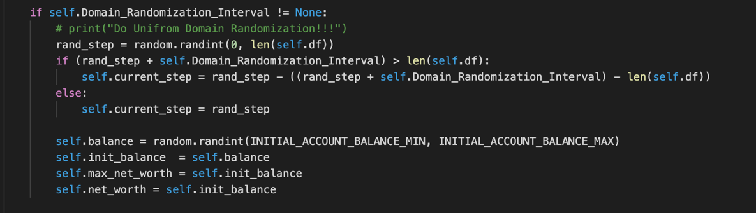
Applied Data Augmentation with Domain Randomization
To ensure the sim2real, and let our agent to experiencing different gym environment conditions as much as possible during training, I applied Uniform Domain Randomization that proposed by this paper Domain Randomization for Transferring Deep Neural Networks from Simulation to the Real World, to randomized the agent’s starting balance, starting date etc..
Randomizable variables during each updated iterating interval:
Initial balance
Starting date

Slide 20
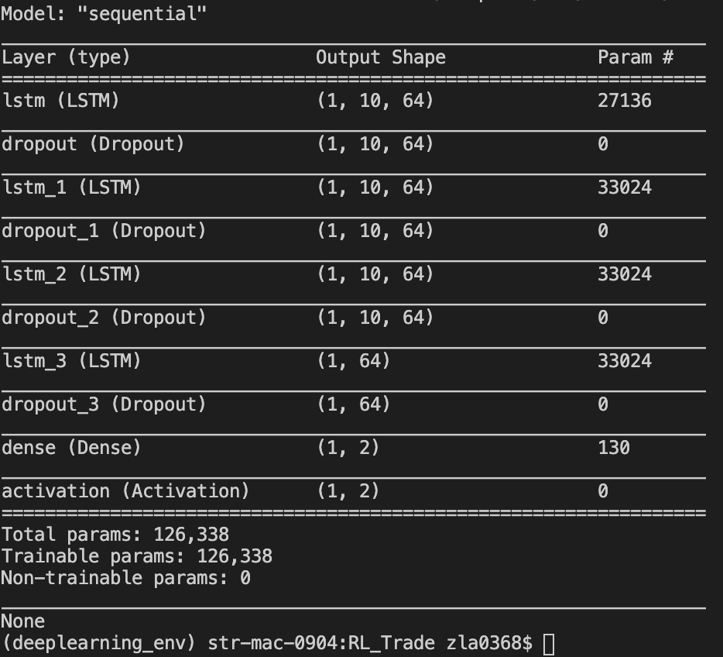
Approach 1 v2 – DQN with More LSTM Layers
Our problem is a semi continuous problem. We do have discrete actions: Buy. Sell and Hold. But we also have continuous number of shares we can buy/sell
I utilized the LSTM as the main architecture for our agent’s action prediction model with more layers

Slide 21
Approach 2– DQN V2 with UDR + LSTM Layers - Results
The updated V2 with UDR model were trained with 5 different 200 days
For Testing: epsilon = 0.5
We started to see that the agent is having a more decent trading policy to be able to perform buy low sell high

Slide 22
Approach 1 v2 – DQN with LSTM Transfer Learning
I also conducted transfer learning for RL agent. Train the action prediction model with 20 years of stock daily
MSFT market data. And then train the same model with 20 years of Apple data and ran the test on the 07-09 data
We started to see that the agent is having a more decent trading policy to be able to obtain more net worth

Slide 23
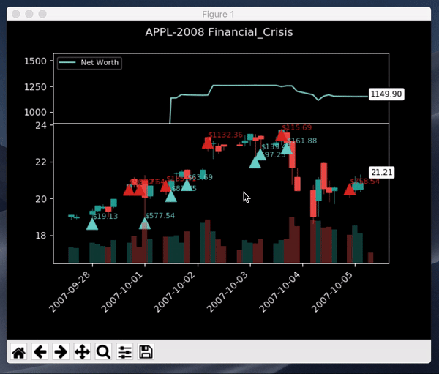
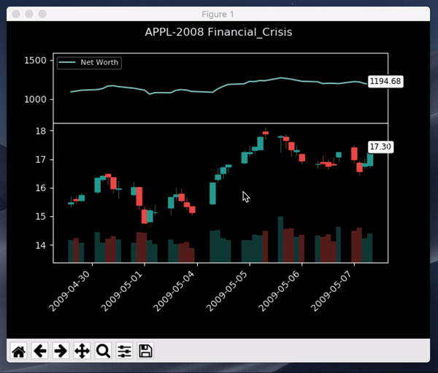
Approach 1 v2 – DQN with LSTM Transfer Learning
Transfer learning from learning with Microsoft data to Apple data
The overall close price trajectory of AAPL (Sep 07 – Sep 09)
The overall close price trajectory of AAPL (Sep 07 – Sep 09)

Slide 24
Approach 1 v2 – DQN with LSTM Transfer Learning
Test the TL model on Microsoft data during the COVID Pandemic period Jan 2020 – May 2020

Slide 25
Approach 1 v2 – DQN with LSTM Transfer Learning
Test the TL model on Apple data during the COVID Pandemic period Jan 2020 – May 2020

Slide 26
Approach 2 – Actor-critic model
Try out a real continuous multi-inputs duel models approach
My SC-DQN implementation is built on top of another open source reference by Yash Patel

Slide 27
Approach 2 – Actor-critic model - Results
Trained the A2C model with UDR for 5 different 200 days
For Testing: epsilon = 0.5
Based on the fluctuations of the account balance, A2C model is performing much more stochastically

Slide 28
Approach 2 – Actor-critic model - Results
Using the agent’s net worth over time as the performance indicator, the agent’s performance seems aligned

Slide 29
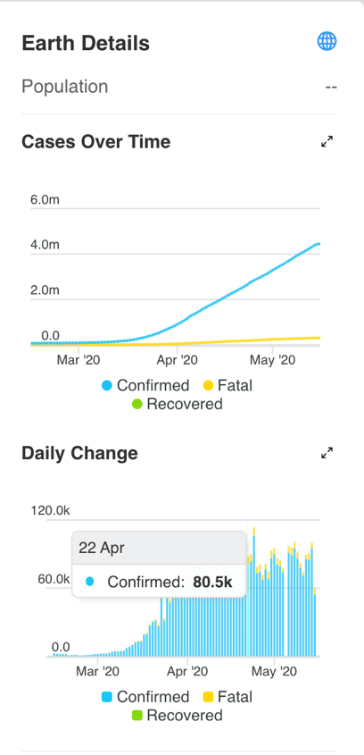
Future Works
Try LSTM in the A2C model
Try more efficient Proximal Policy Optimization (PPO)
Try to train the models with higher resolution data, hourly or per minute data with much more iterations
Try to incorporate COVID data into the reward formula
Try different Gym environments
BTGym
Incorporate COVID data into the reward formula

Slide 30
Summary
This experiment shows there is still a lot of factors to train and affect the agent’s performance. As you can see from the right. Not all the runs with the same agents can produce consistent outputs due to the model is still basically relying on the random sampling action that determine by the epsilon, even with lower epsilon during testing. We definitely need to have more robust training environment and data for training.
Github link:
https://github.com/heng2j/RL-Trade

